Slide 1

Fork Yah!
Forkin’ Fast
Food Delivery

Slide 2

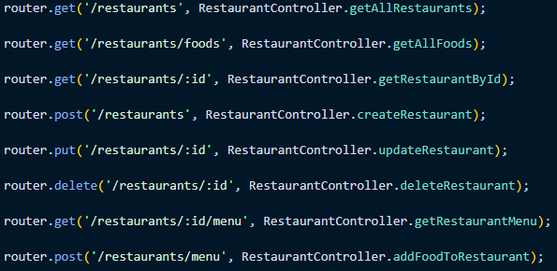
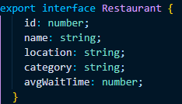
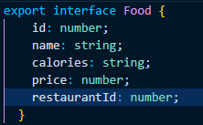
REST API’s
Here we have two objects that make up the food delivery application. The REST API entry points all have to go through the restaurant controller to access the food controller in a hierarchical structure. All HTTP methods can be executed on the Restaurant Model, while only PUT and GET can be executed on the Food Model

Slide 3
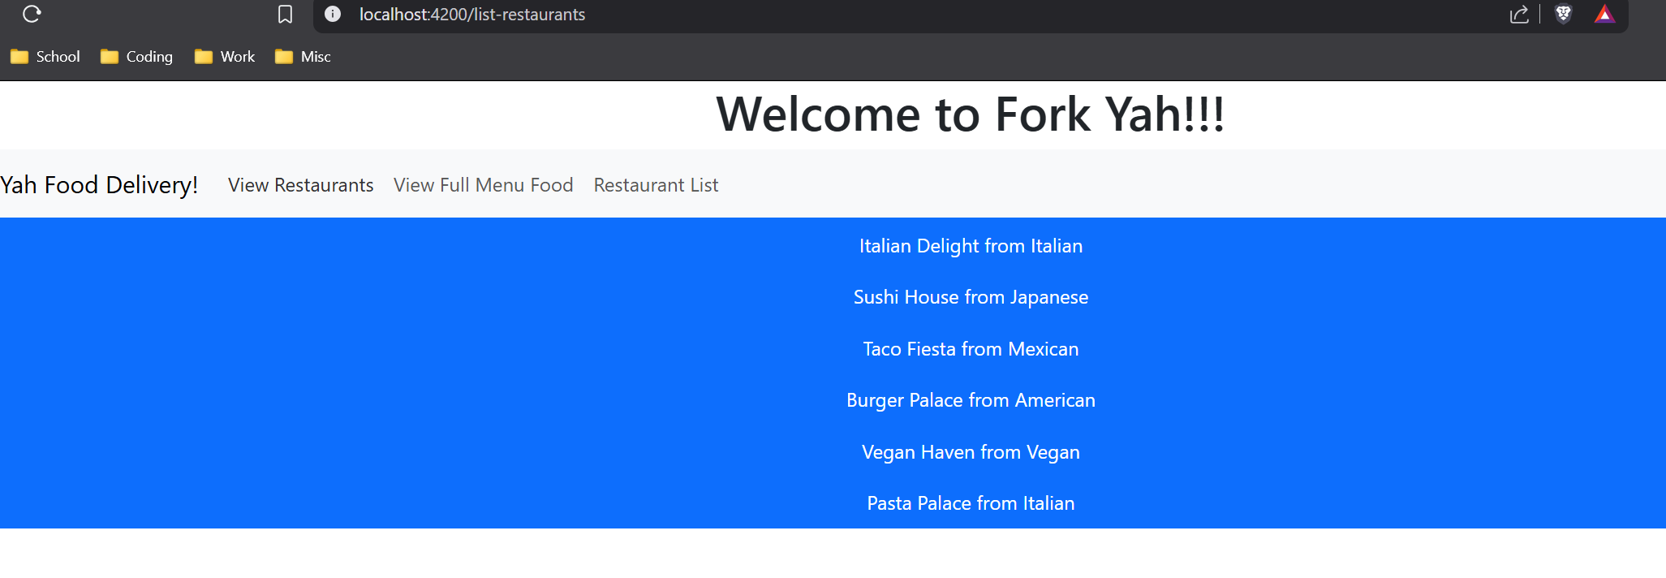
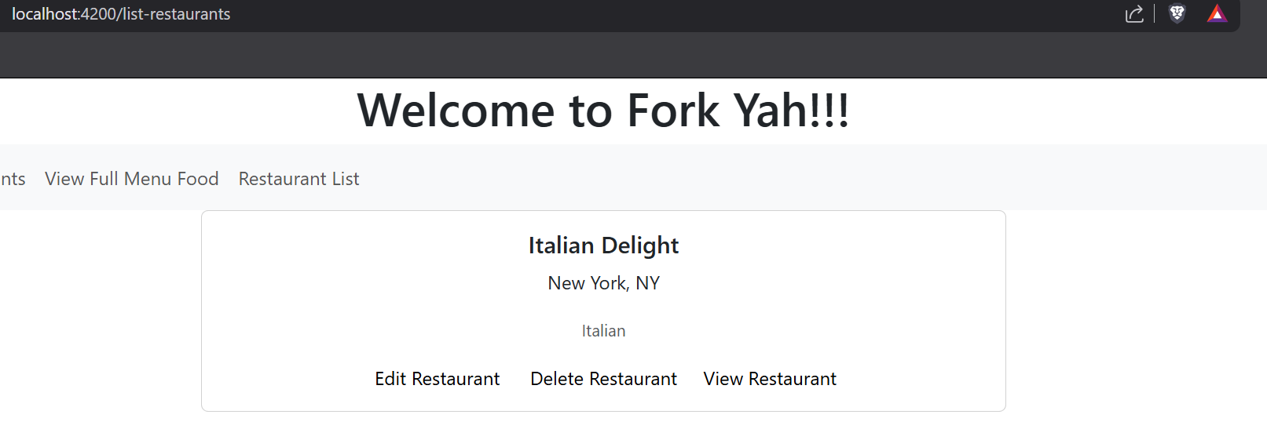
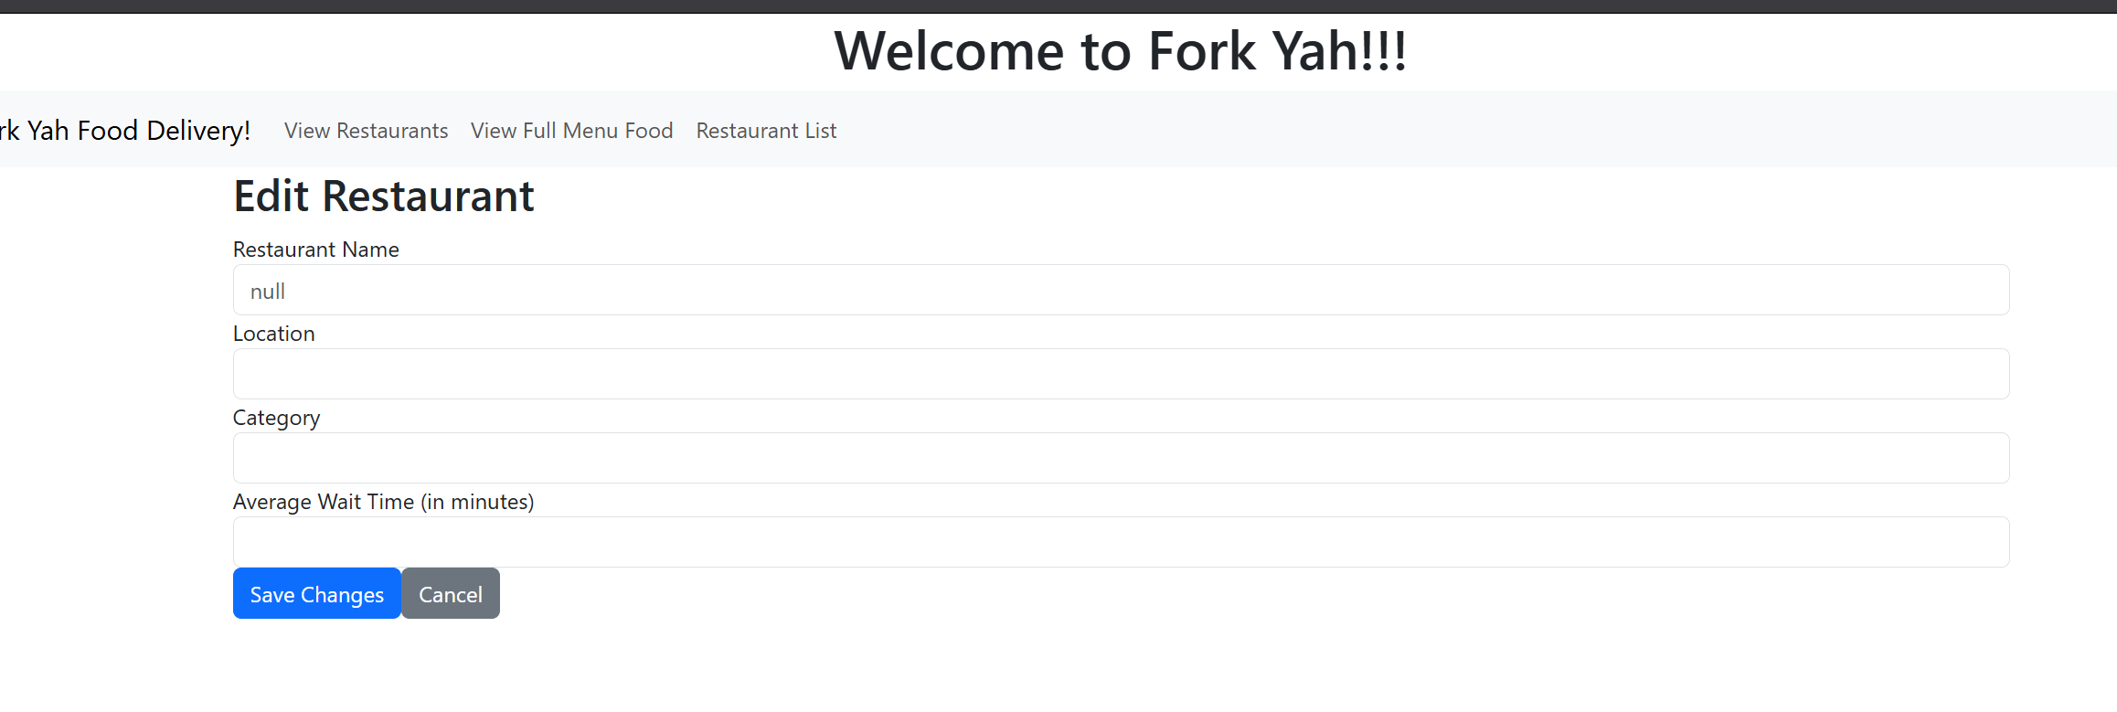
UI Application
Here we have the front end of the application. The UI interacts with the API to retrieve the necessary data from the MySQL database and display it for the user to see and interact with.
So far, the application is able to retrieve the list of restaurants, select an individual restaurant, and enter an edit form page to update the restaurants information. The edit page is not able to update the restaurant yet, and the create and delete functions have not been implemented yet.
Unfortunately, due to technical difficulties with my computer, I am unable to complete the project at this time, and will need to implement the delete, create, and finish the update functions by next milestone.

Slide 4
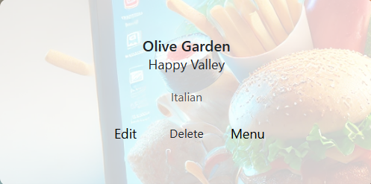
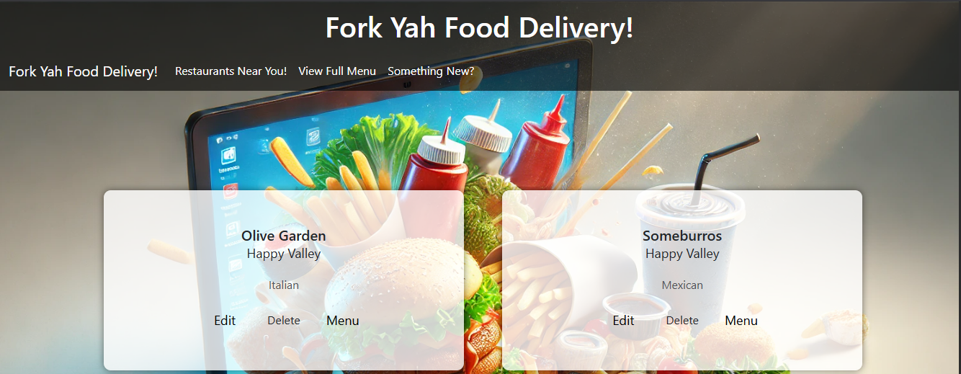
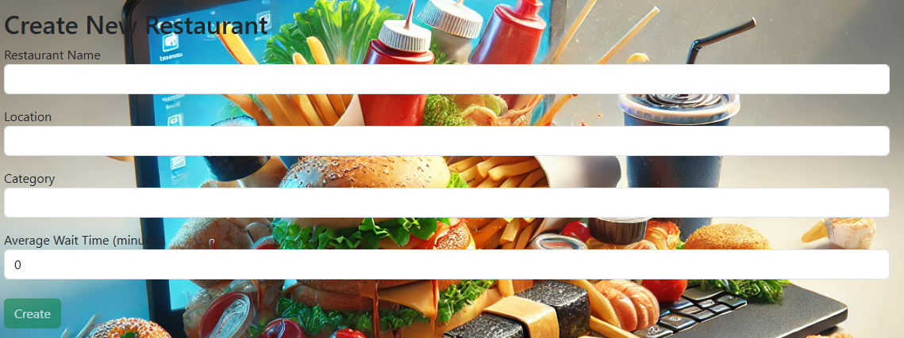
CRUD Functions
CRUD Operations are now fully Functional for the restaurants, although there is no way to add food to the restaurants themselves.
The UI has been greatly improved visually, making it much more appealing and user friendly.
There is a new page for creating the restaurants, and another for viewing all of the foods available.

Slide 5
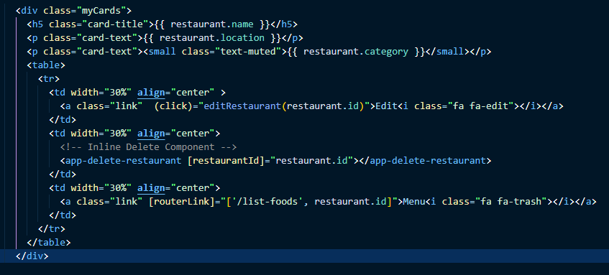
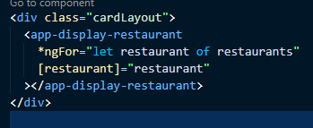
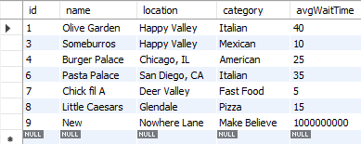
Component Code
I utilized Card components for displaying the restaurants, making it easier to keep the components running on one page instead of redirecting to other pages.
I have also utilized components within components, so the user can jump between multiple functions, without ever leaving the same page.
The frontend successfully interacts with the API, and that with the database to add or remove data.

Slide 6

Pending Bugs & Future Plans
The Restaurants aren’t displaying their menus, nor does the big menu display the corresponding restaurants
The Create page’s UI needs to be touched up
There needs to be a shopping cart tool and checkout capabilities
A map with live updates should be included

Slide 7
Demo

Slide 8
Website Accessibility
As a follower of Christ, I am called to serve others, as Jesus came to serve, not to be served. Accessibility in web development ensures that all people who need the web sites services, regardless of their capabilities, or lack there of, are able to use them at their need. It is very important, therefore, to take all steps necessary to ensure your website is fully usable for anybody by including elements such as these in your applications:
Semantic HTML
Alt Text
High Color Contrast
Keyboard Navigation
These are just to name a few, but even just including these elements in your application makes a world of a difference to those who struggle to access you web services. Helping those in need is a vital piece of God’s purpose for humans, and this is the best way to incorporate that message into my career as a web developer.

